Slide 1
Healthcare Analytics
PROJECT - 260
GROUP - 02

Slide 2

Mentor: Mr. Mahendra singh Project Members : Mr. Sudhakar Yadav Miss. Pallavi Jadhav Mr. Sharvil Sutar Miss. Niharika Panda Mr. Pradeep Kumar

Slide 3





Table of contents
01
03
05
02
04
KPI’s
Tableau Dashboard
SUMMARY
A dashboard in Tableau is a collection of views that allows you to compare data simultaneously
Dashboards can display relevant, actionable data, track stats, and key performance indicators (KPIs).
Excel Dashboard
Power-Bi Dashboard
An Excel dashboard is a visual representation of data that provides an overview of metrics and other data points in one place
Microsoft Power BI is a business analytics service that helps users visualize and share insights from their data

Slide 4
KEY PERFORMANCE INDICATOR(KPI’s)
Total Discharge
Net Patient Revenue
Revenue Trend
Patient Stays
State Wise No of hospitals /Revenue
Type Of hospital Revenue
MTD/QTD/YTD Revenue
Total Patient, Total Doctor, Total Hospital

Slide 5
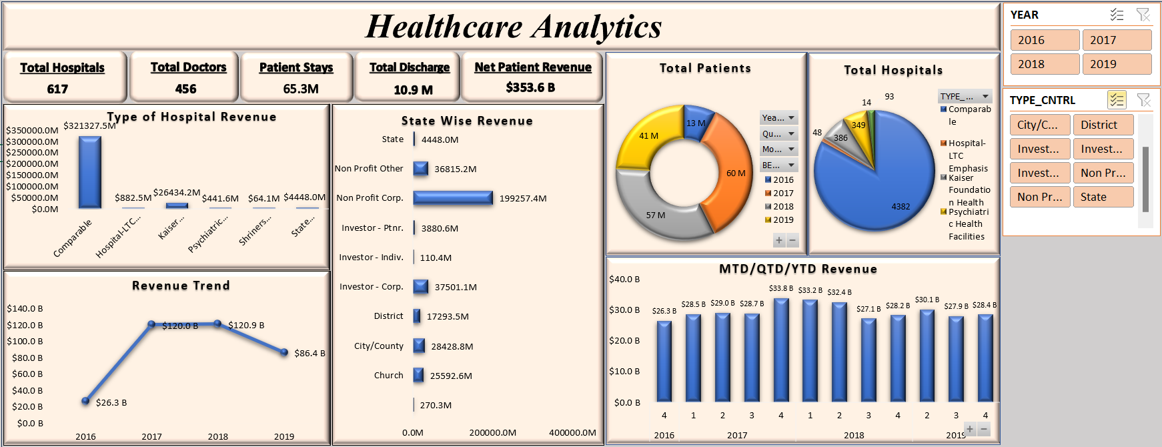
Excel Dashboard

Slide 6
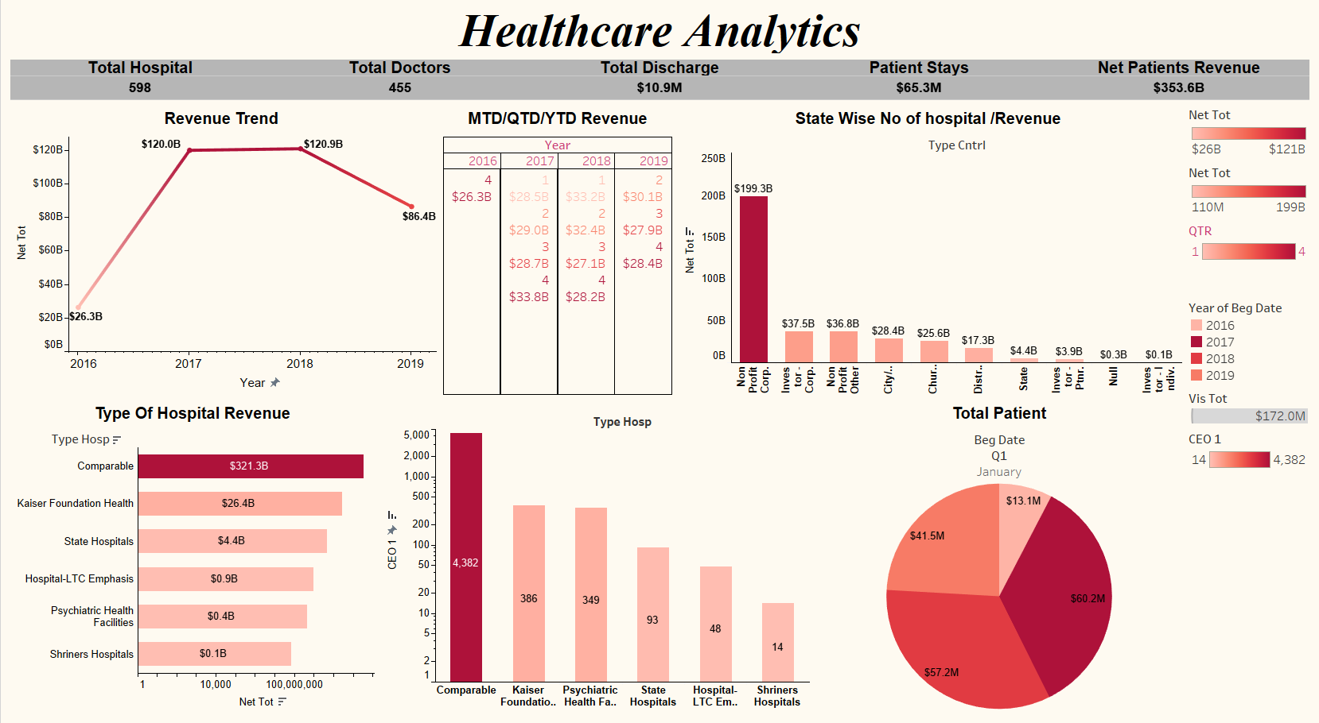
Tableau Dashboard

Slide 7
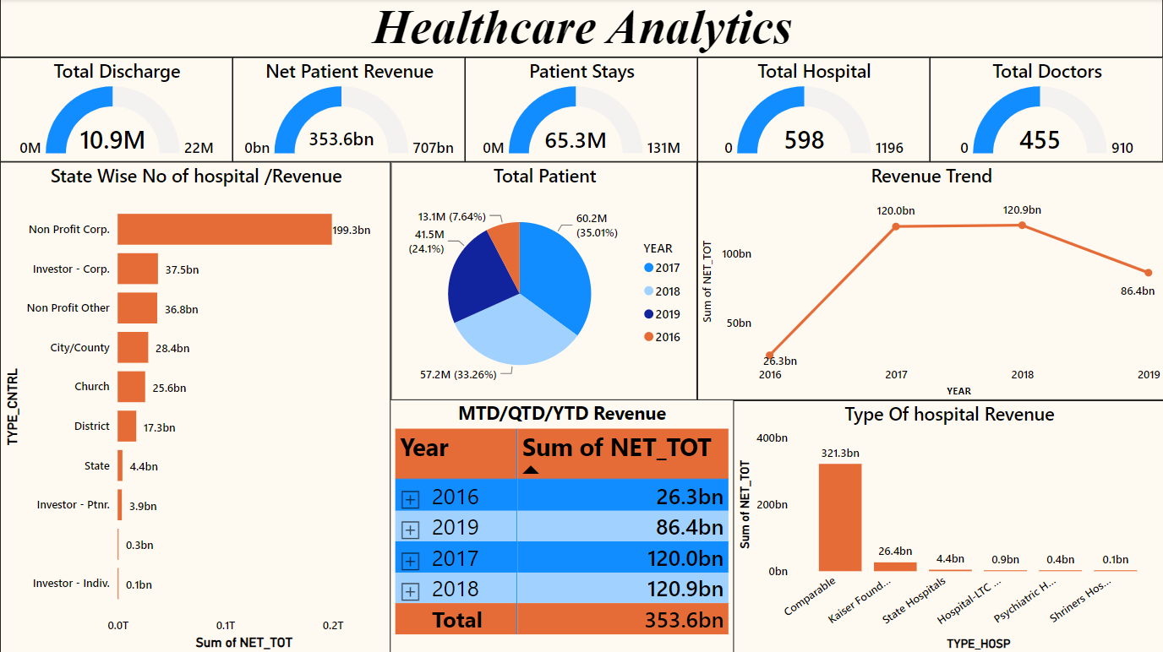
Power BI Dashboard

Slide 8
SUMMARY
In our analysis of healthcare facility data, we've uncovered valuable insights that offer a comprehensive view of our organization's performance. The dataset includes a wide range of metrics, enabling us to assess various aspects of our operations, finances, and patient demographics. Below are the main findings and trends:
1. Facility Information:
We have data on facilities, including names, types, control categories, locations, and contact information. This information provides a foundation for understanding our network.
2. Operational Status:
Operational status data allows us to assess the functioning of our facilities and make informed decisions regarding resource allocation.
3. Patient Data:
Our dataset includes comprehensive information on patient stays, including various measures such as discharges, patient days, and visit statistics. This provides insights into patient flow and service utilization.

Slide 9
4. Revenue and Financials:
Detailed financial data, including net patient revenue, revenue trends, and various adjustments, helps us gauge our financial health and make informed financial decisions.
5. Types of Hospitals:
We have information on different types of hospitals within our network, such as teaching hospitals, rural facilities, etc. This data allows us to assess the performance of these specific categories.
6. Geographical Data:
County-wise and state-wise data provides a regional perspective on the performance and impact of our facilities.
7. Quality Assurance and Managed Care:
Quality assurance fees, supply payments, and managed care quality assurance payments help us evaluate our commitment to quality healthcare delivery.
8. Revenues and Expenses:
Revenue sources, operating expenses, and capital expenditures are critical for understanding the financial health of our organization.
9. Patient Demographics:
Demographic data, such as the number of patients, doctors, and hospital beds, offers a glimpse into our network's size and capacity.

Slide 10
THANK YOU

